Slide 1


This analysis contains information about team members’ performance regarding Sponsorships & Bookings from July 2023 to June 2024.
Title: Team Performance Analysis
“Sponsorships & Church Bookings”(2023 - 2024)
Key Metrics
Overall Team Performance
Regional Performance
Individual Performance
Monthly Trend Performance
Target Achievement rate
Top Performers & Underperformers
>
Presenter : Adeola Haruna

Slide 2
Performance Snapshot
98.9%
99.5%
North
Sponsorships Actual
Church Bookings Actual
Best Region
Current achievement level for sponsorships across all regions and team members
Current achievement level for church bookings across all regions and team members
Overperformed by 11.7% in Sponsorships & by 7.3% in Church Bookings
Geoffry
Chris
April & June 2024
Best Performer
Worst Performer
Peak Months
With an achievement level of 146% in sponsorships and 117% in Church Bookings
With an achievement level of 77% in sponsorships and 67% in Church Bookings
Average performance of 108% in the most recent quarter, showing positive momentum

Slide 3
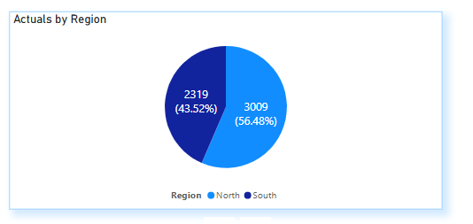
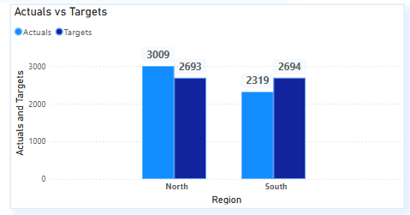
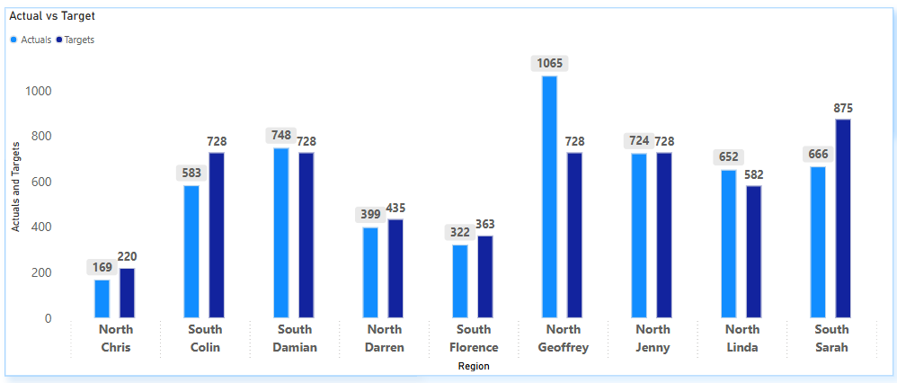
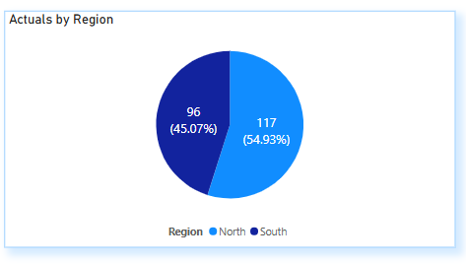
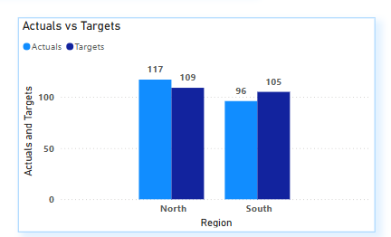
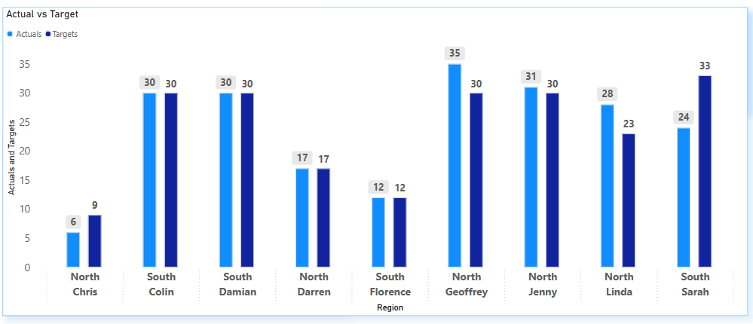
Regional Performance
Regional Performance Gap
Team Member Performance By Region
Sponsorships
+11.7%
-14%
Highest
Lowest
>
>
Church Bookings
-8.6%
Highest
7.3%
Lowest

Slide 4
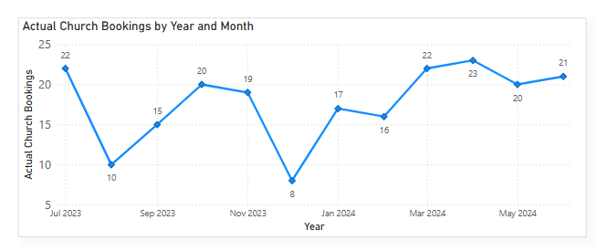
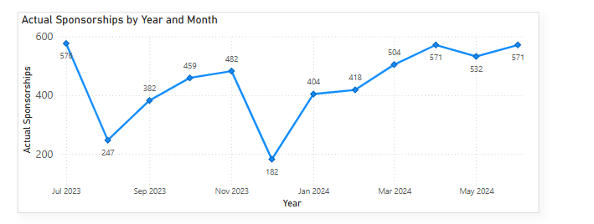
Trend Performance
Target Achievement rate
Peak Month
Church Bookings
Church Bookings Performance
Team member | LOS (Years) | Region | Q1 Achvt | Q2 Achvt | Q3 Achvt | Q4 Achvt | FY Achvt | NO Months Above Target
Chris | 2 | North | 67% | 0% | 0% | 0% | 67% | 2
Colin | 4 | South | 100% | 100% | 114% | 89% | 100% | 7
Damian | 5 | South | 100% | 100% | 100% | 100% | 100% | 12
Darren | 1 | North | 0% | 60% | 100% | 133% | 100% | 7
Florence | 3 | South | 100% | 100% | 100% | 100% | 100% | 11
Geoffrey | 3 | North | 114% | 129% | 114% | 111% | 117% | 12
Jenny | 8 | North | 114% | 100% | 100% | 100% | 103% | 12
Linda | 14 | North | 33% | 140% | 150% | 167% | 122% | 9
Sarah | 6 | South | 56% | 71% | 88% | 78% | 73% | 4
Total |  |  | 84% | 100% | 108% | 107% | 100% | 9
Weakest month
Weakest month
>
Peak months
Sponsorships
Sponsorships Performance
Team member | LOS (Years) | Region | Q1 Achvt | Q2 Achvt | Q3 Achvt | Q4 Acovt | FY Achvt | NO Months Above Target
Chris | 2 | North | 77% | 0% | 0% | 0% | 77% | 1
Colin | 4 | South | 79% | 80% | 80% | 82% | 80% | 0
Damian | 5 | South | 93% | 111% | 101% | 106% | 103% | 8
Darren | 1 | North | 0% | 34% | 107% | 123% | 92% | 7
Florence | 3 | South | 120% | 65% | 92% | 77% | 89% | 3
Geoffrey | 3 | North | 131% | 173% | 138% | 146% | 146% | 11
Jenny | 8 | North | 110% | 104% | 74% | 107% | 99% | 8
Linda | 14 | North | 23% | 109% | 155% | 157% | 112% | 8
Sarah | 6 | South | 62% | 69% | 100% | 75% | 76% | 3
Total |  |  | 85% | 95% | 105% | 109% | 99% | 6
Weakest month
LOS – Length of Service

Slide 5






Key Insights
1. Overall Performance & Individual Performance
The team achieved 98.9% of sponsorship targets and 99.5% of church booking targets.
While church bookings exceeded targets, sponsorships fell slightly short, indicating a need for improvement.
Top performers like Geoffrey, Jenny, and Damian drove the majority of the team’s success, Geoffrey stands out with a 146% Achievement rate, while underperformers like Florence, Darren, Colin and Chris dragged down overall results. Sarah’s performance was inconsistent, with some months exceeding targets and others falling short.
2. Monthly Trends
Peak Months: April 2024 and June 2024 were the best-performing months for sponsorships and church bookings.
Low-Performing Month: August 2023 & December 2023. Dec 2023 was the weakest month, with significant dip in both sponsorships and church bookings.
Seasonal Impact: The data suggests seasonal challenges, especially during the holiday season (December).
Overall, the team shows improvement in 2024 compared to 2023
3. Regional Performance
North Region:
Outperformed the South region in both sponsorships and church bookings, driven by strong performers like Geoffrey and Jenny.
South Region:
Lagged behind the North, with only Damian consistently meeting or exceeding targets.
Florence and Colin’s underperformance significantly impacted the South region’s results
4. New Hire
Darren joined in October 2023 and showed steady improvement, achieving 50% growth, in sponsorships by June 2024.
His ramp-up time was approximately 5-6 months, suggesting room for faster onboarding and training. He contributed positively over time but took longer.
5. Staff Exit
Chris left the team in August 2023 after joining in February 2022.
His departure created a temporary gap in performance, especially in the North region, where he was a key contributor.
The team’s performance dipped slightly in the months following his departure, indicating the need for succession planning.

Slide 6







Actionable recommendations
Training and Support for Underperformers
Incentives for Top Performers
Regional Strategy
Regular Performance Reviews
Leadership Development
Improve Onboarding for New Hires
Succession Planning
Provide additional training for Florence and Colin to help them close performance gaps
Consider assigning a mentor from the top-performing team members (e.g., Geoffrey or Damian).
Encourage top performers to share their strategies and techniques with underperforming team members.
Recognize and reward top performers like Geoffrey, Jenny, and Damian to maintain their high performance.
Introduce performance-based bonuses to motivate the team.
Identify root cause of performance gap in south & implement corrective measures of success in the north region.
Focus on improving performance in the South region, particularly for Florence and Colin.
Use Damian’s success in the south as a benchmark to improve performance.
Share best practices from the North region to help the South region improve.
Implement monthly performance reviews to identify and address issues early.
Set clear, achievable targets for underperforming team members.
Identify potential leaders within the team (e.g., Geoffrey, Jenny, Damian) for future leadership roles or mentorship programs and invest in their professional development for
future responsibilities
Ensure continuity by cross-training team members.
Provide better mentorship and training for new hires like Darren
Prepare for the potential departure of long-tenured employees like Linda by identifying and training their successors.

